Slide 1

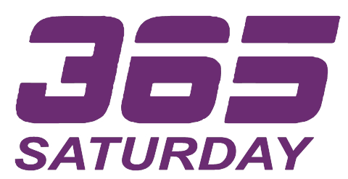
“There can be no greater gift then that of giving one’s time and energy
to help others without expecting anything in return”
– Nelson Mandela

Slide 2

INTRO TO COMMON DATA SERVICE
VICTOR DANTAS / MICROSOFT MVP

Slide 3
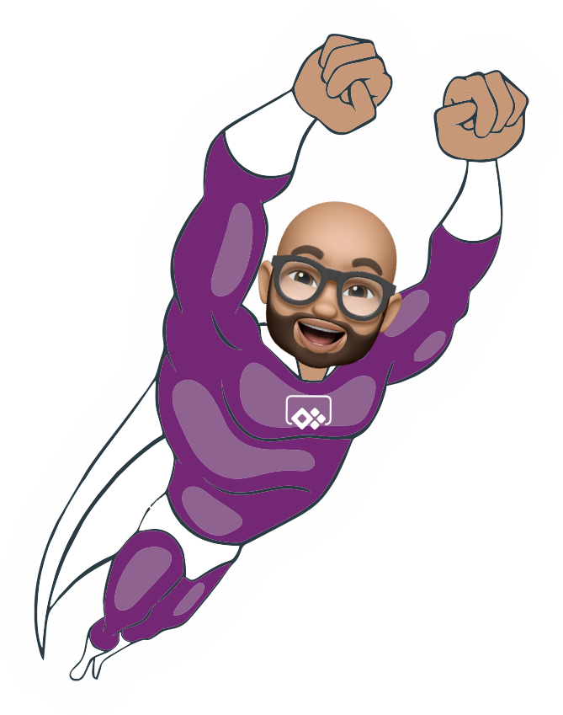
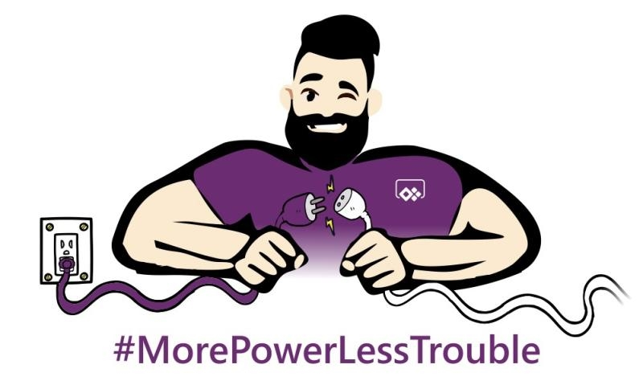
Introduction
To CDS
Victor Dantas
#EmPowerYourCareer

Slide 4
Session Objectives
What it is? What it is not?
How to get started?
Best Practices
#EmPowerYourCareer

Slide 5
Agenda
Overview
CDS / CDM
Components
Building a Model
Getting Data Into it
Accelerators
Useful Links
#EmPowerYourCareer

Slide 6

Intro do CDS
David Yack – Microsoft MVP
Julie Yack – Microsoft MVP (Mom of all MVPs ☺)
#EmPowerYourCareer

Slide 7
Overview
The Common Data Service (CDS) is a key component of the Power Platform and provides data storage and related business logic execution.
CDS implements the Common Data Model (CDM) allowing it to be part of the data fabric in an organization with a common way of describing core business data.
#EmPowerYourCareer

Slide 8
History
While the CDS name is relatively new, the core engine for CDS came from Dynamics 365 Customer Engagement (originally named Dynamics CRM).
Microsoft broken out specific product/apps parts and renamed the core as CDS.
#EmPowerYourCareer

Slide 9
CDS vs. Excel, Access, SP, SQL
There is a wide variety of choices for data storage when it comes to business application data.
CDS, will always be the most supported data storage option within the Power Platform.
#EmPowerYourCareer
Notes:
Excel: Often starting point for automation because it broadly used by business power users. An Excel file would be equivalent to a CDS entity. Excel however, lacks scalability and it sucks when it comes to governance and manageablilty. Access: It has been widely used as business apps engine in the past. Really fit the bill, but also fell short as technology option when dealing with large amounts of data. CDS advantages over access, is the amount of connectors available in the market.
Sharepoint: If you are familiar with SP, you find that when using SP in combination with other Power Platform components will get you way ahead of the crowd, but CDS will surpass SP, when you need relational DB setup. SP lists won’t work well under that particular scenario. SQl Server: The most advanced and reliable data storage technology in this discussion, but does not offer the almost “automatic” abstrations that CDS offers. When we wild a database in CDS, we automatically inherit Security features, Forms, Views, import and Export capabilities, and webapi extensibility.

Slide 10
CDM
The Common Data Model (CDM) is simply the entity (table) definitions of commonly used business data. The CDM does not prescribe an implementation of the data processing itself.
It defines what makes up the core definition of the entity(ies).
#EmPowerYourCareer

Slide 11
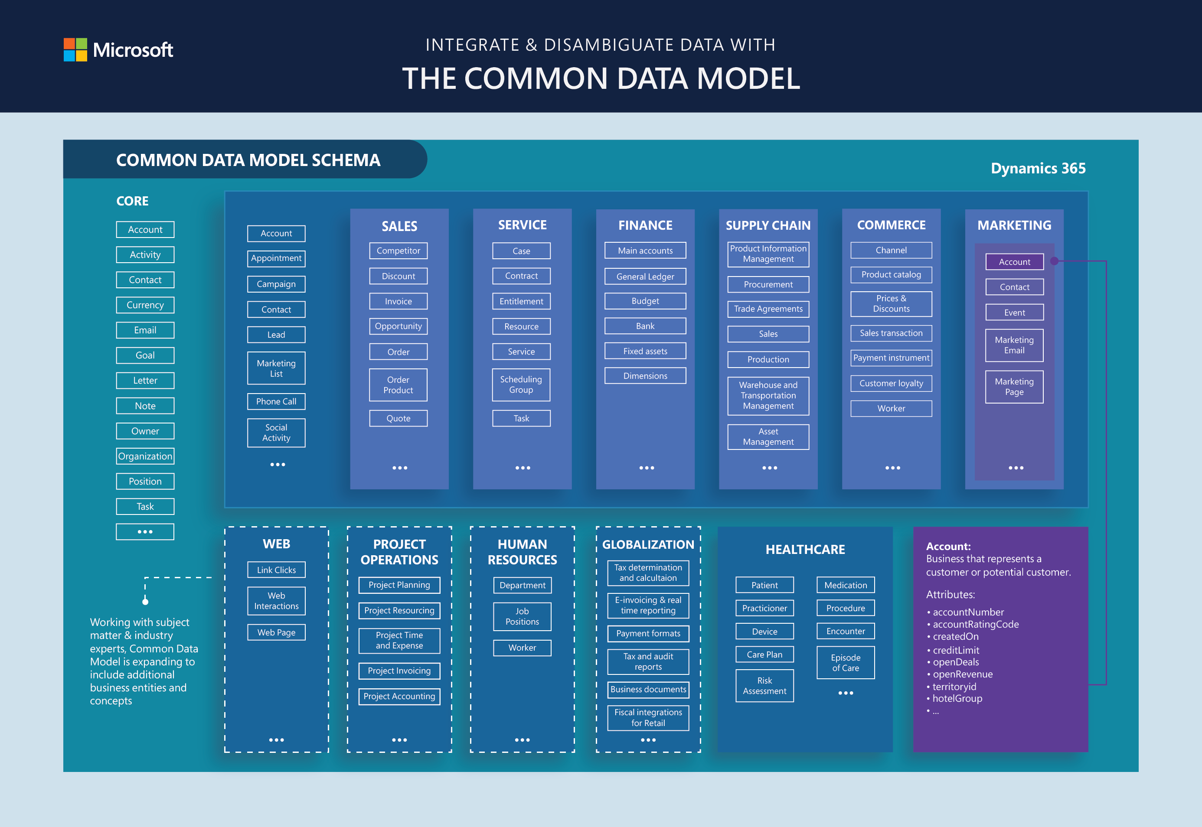
CDM – Core Entities
#EmPowerYourCareer
Notes:
Explain: Environments, Solutions, Entities

Slide 12
Getting Started
Community Plan:
https://powerapps.microsoft.com/en-us/communityplan/
Existing Tenant
https://admin.powerapps.com
#EmPowerYourCareer

Slide 13
Demo
Building a simple appointment booking system
#EmPowerYourCareer
Notes:
1 - Accessing CDS
2 – Create Solution File
3 – Create Entity
4 – Create Attributes
5 – Create Business Rules
6 – Show Sample Flow
7 – Create Canvas App

Slide 14
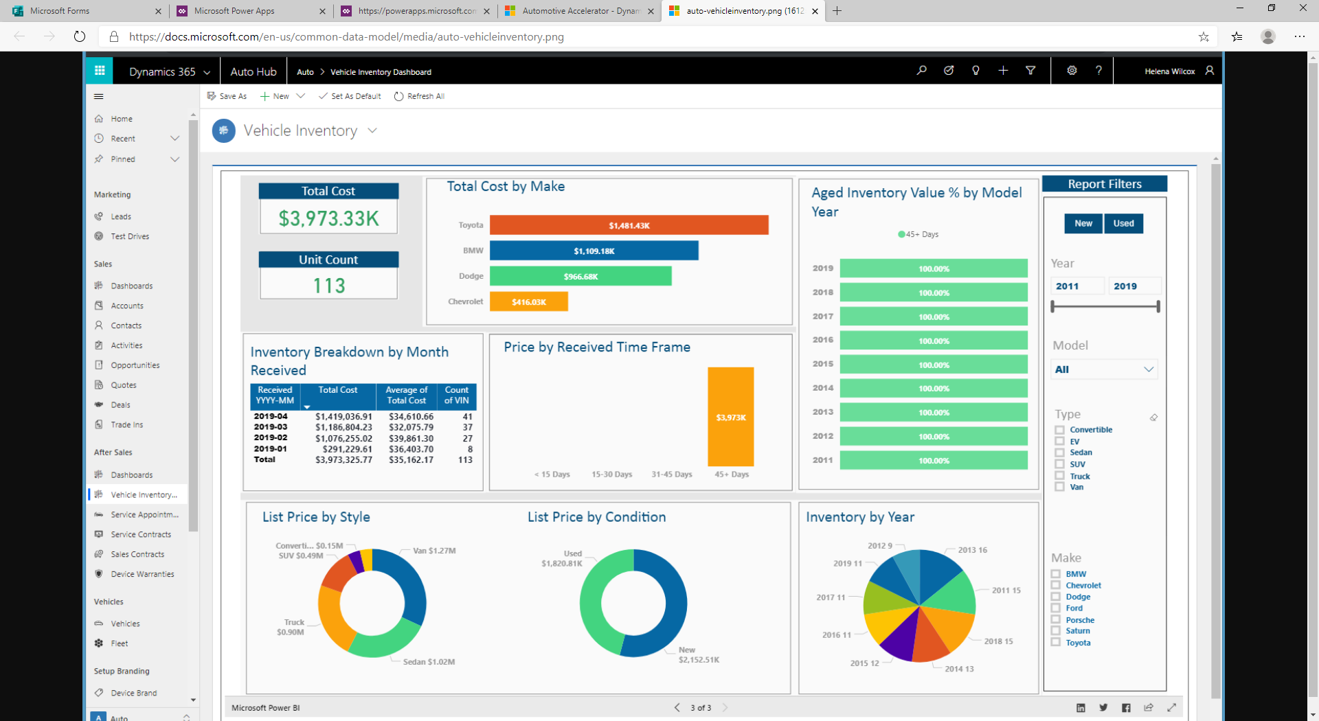
Accelerators
#EmPowerYourCareer
Notes:
https://docs.microsoft.com/en-us/common-data-model/industry-accelerators

Slide 15
Reference Links
Free CDS Training : https://docs.microsoft.com/en-us/learn/paths/get-started-cds/
Accelerators: https://docs.microsoft.com/en-us/common-data-model/industry-accelerators
CDS Tools: https://cds.tools
XrmToolBox: https://www.xrmtoolbox.com
#EmPowerYourCareer

Slide 16
Q&A
#EmPowerYourCareer

Slide 17
“As Iron sharpens
Iron, so a friend
sharpens another.”
#EmPowerYourCareer

Slide 18
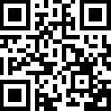
Please fill out
the survey!
#EmPowerYourCareer

Slide 19
Thank You for Attending

